Slide 1
Oral Presentation Template
Choose a title slide of your preference
Notes:
Choose a title slide of your

Slide 2
Choose a title slide of your preference

Slide 3
Choose a title slide of your preference

Slide 4
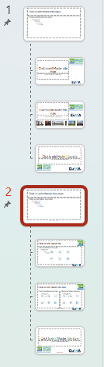

Personalise this template
Edit the Slide Master to personalise the template
  menu: View – select: Slide Master
  Select number 2 template style
  Change the “Presentation title” in the footer at the centre of the page
  Add your institution logo to any free area of the footer or header if you wish
  You can also add your institution logo to any free areas of template style 1 (the title slides) if you wish
  Menu: View – select:

Slide 5
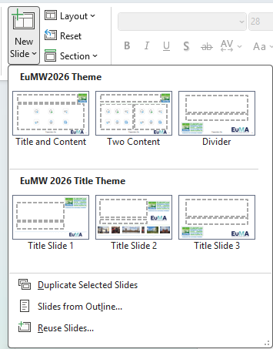
Title and content slide example
Insert new slides using
  Home menu then select New Slide
  Or Insert menu then New Slide
Choose a style to include in your presentation

Slide 6
Section Divider Example
Customise as you wish

Slide 7
Two Content example
Use for text or diagrams
Use for text or diagrams
Freely customise central areas of Title and content or Two content slides to suit your presentation

Slide 8
Use a divider or title slide to conclude your presentation if you wish

